Slide 1

Review of Python for Data Science
CADS Workshop Fall 2022

Slide 2
What will we cover in this workshop?
Yes
Basics of strings and lists, because these are used all the time in data work
List comprehensions, because of their connection to map/reduce
Computing in notebooks
Fundamental data types: Series, DataFrame
Subsetting and sorting DataFrames
Other commonly useful pandas tools
No
Control structures (if, for, etc.)
Software development
How to install Python or Jupyter
Anything really advanced

Slide 3
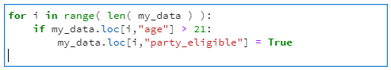
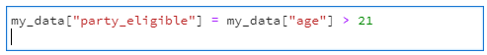
Data Science is not software development
Loops and conditionals are standard coding tools:
Data science code can almost always omit them!
Notes:
If you’re writing loops and conditionals, you may be doing something wrong, because there’s usually a shorter way in data-related code.
Don’t worry if these two code snippets are not 100% comprehensible.
We will see later in this slide deck exactly how to write code like the bottom example (which is the better one).

Slide 4
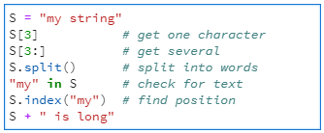
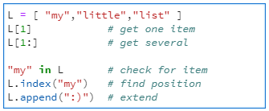
Data work uses strings and lists frequently
Common string tools
Common list tools
Notes:
Go through these and notice the similarities aligned horizontally.
Note that S.split() actually produces a list.
Notice that the top line is how to create a string/list from scratch.

Slide 5
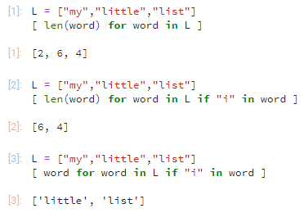
List Comprehensions (How to play with lists without writing loops.)
Notes:
Top example: How to do a computation to each thing in a list (producing another list)
Next example: How to choose just some of the original list’s entries to operate upon.
Final example: How to just filter without actually doing any computation.

Slide 6
Notebooks (Jupyter, etc.)
Notes:
We will not tell you here what tools you have to use; maybe your instructor cares but we do not.
But since notebooks are really common in data science work, I wanted to just say a few things about them…

Slide 7
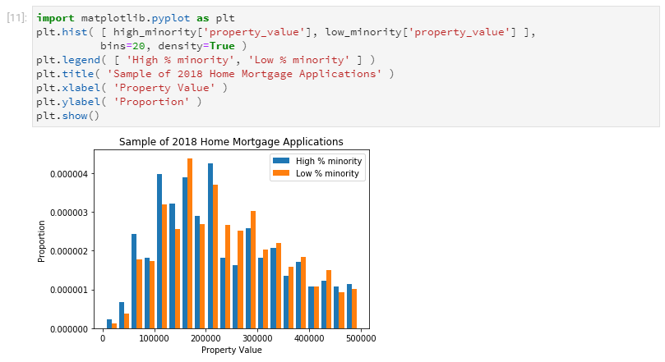
Notes:
1. The last thing in the cell is automatically printed, and sometimes the notebook does it cleverly.
Upshot: you should almost NEVER need to write print() in a notebook.
And doing so often makes things worse than if you had left it out.
2. There are lots of cloud computing options if you’re going to use notebooks
Google Colab
Deepnote
CoCalc
and many others
3. If you’re using a notebook, make good use of it. Put lots of comments between cells.
Not like what you see above, but more like this…

Slide 8
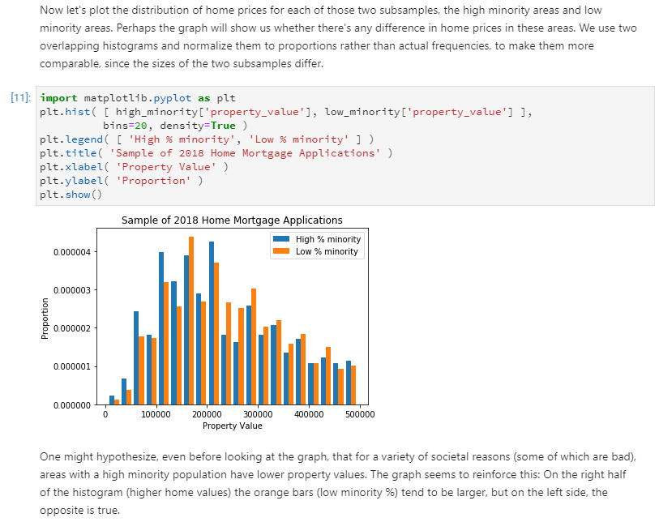
Notes:
That way someone who sees your notebook later (or you in a few weeks!) will know what’s going on.

Slide 9
pandas data types
Notes:
When doing data science in Python, 99% of people use pandas.

Slide 10
pandas data types
pd.DataFrame
pd.Series
pd.Index
Notes:
In short:
- A Series is a column
- A DataFrame is a whole table
- and the Index is special but we almost never manipulate it so it doesn’t matter.
Get to know the things you can do with a Series and a DataFrame! There are a million of them!
The more you know the easier your job will be.
Let’s see some examples.

Slide 11
Common actions to take on Series (individual columns)

Slide 12
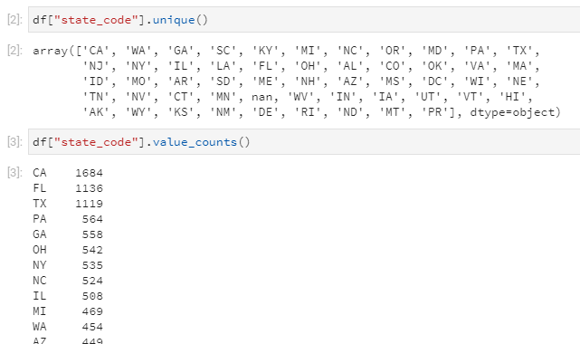
Inspecting the contents of a column
Notes:
Really common to call my main DataFrame df.
Get a column from it with df[“colname”] or just df.colname.
Here are two really useful things you can do with a column, to find out what kinds of stuff are in it.

Slide 13
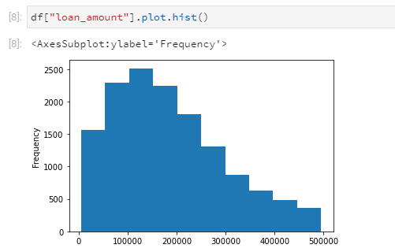
Simple visualization with .plot.type()

Slide 14
Common actions to take on DataFrames (entire tables)

Slide 15
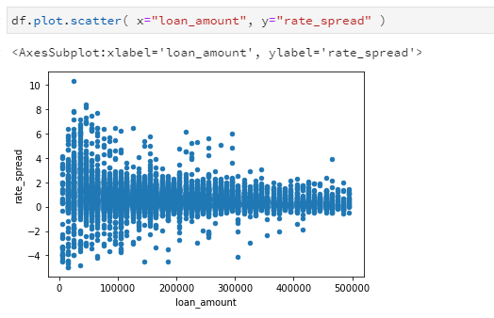
Simple visualization with .plot.type()

Slide 16
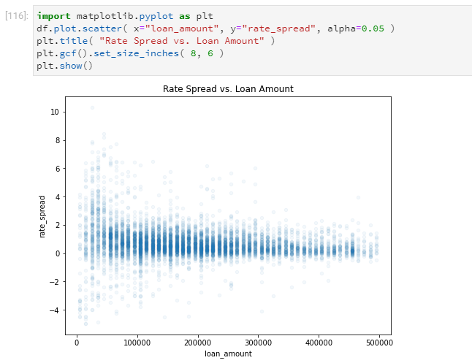
To do better, use Matplotlib explicitly
Notes:
Don’t get into this—just say that for advanced visualization, which we’re not covering, there’s matplotlib.

Slide 17
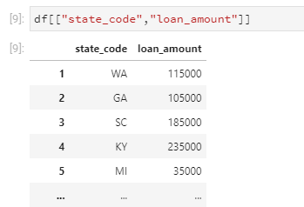
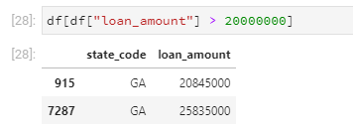
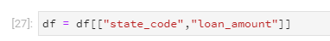
Choose columns
Choose rows
Notes:
Top left:
Very odd, the double brackets
Explain that the outer ones are for lookup
And the inner ones are for making a list of 2 columns
Bottom left:
Distinction between df[[…]] and df = df[[…]]
Top right, assuming we’ve run the bottom left:
Explain how to read from the inside out
Point out vectorization of the > operator

Slide 18
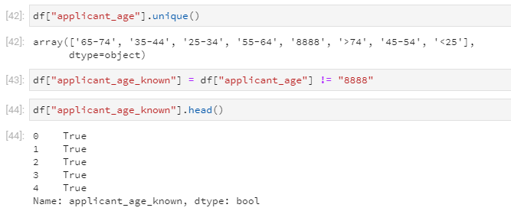
Create a new column
Notes:
Assume applicant_age is a pre-existing column with the categorical values you see there.
And we expect that 8888 means “we don’t know the applicant’s age.”
So we want to create a new column that says “applicant_age_known.” (Just pretend.)
We compute it from a pre-existing column as shown.
We then check to see if it has the right kind of values by looking at just the first few entries.

Slide 19
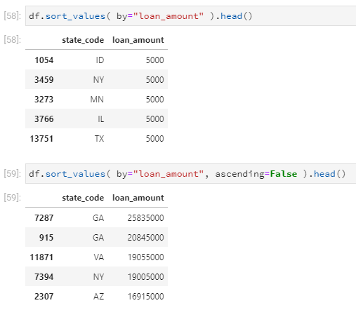
Sort a table
Notes:
You can sort by any column, ascending or descending (ascending is the default).
If you just want to see the results, pair this with head().
If you actually wanted to change the table, this does not do it.
You would need to do df = df.sort_values(…).
And in that case you would not want to use .head(), because that would truncate your data.

